Slide 1

Galaxy Formation and Stellar Evolution in the National Science Olympiad
Asher Noel
Harvard University

Slide 2
Purpose
Spread Awareness about Science Olympiad
Invite Support and Feedback
This Talk
INTRODUCTION
TOPICS
ASTRONOMY 2020
REPRESENTATION
INVOLVEMENT

Slide 3
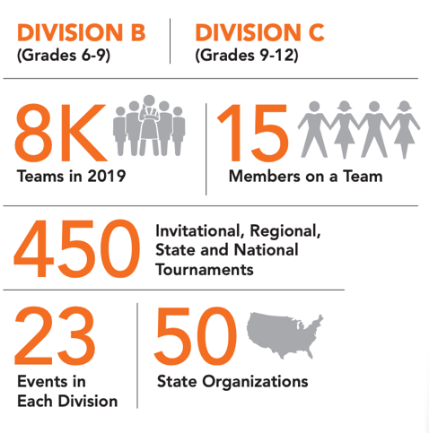
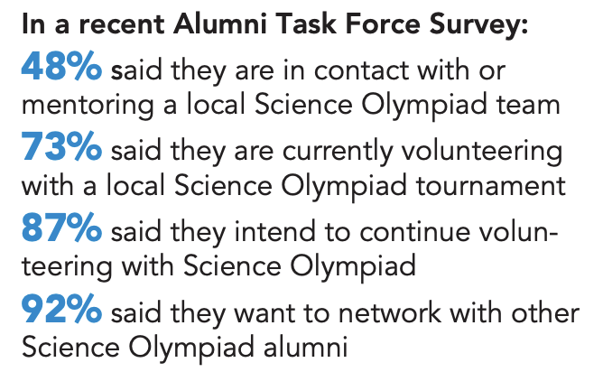
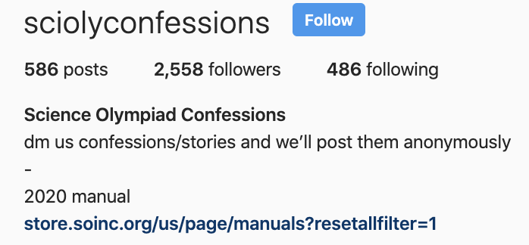
By the Numbers

Slide 4
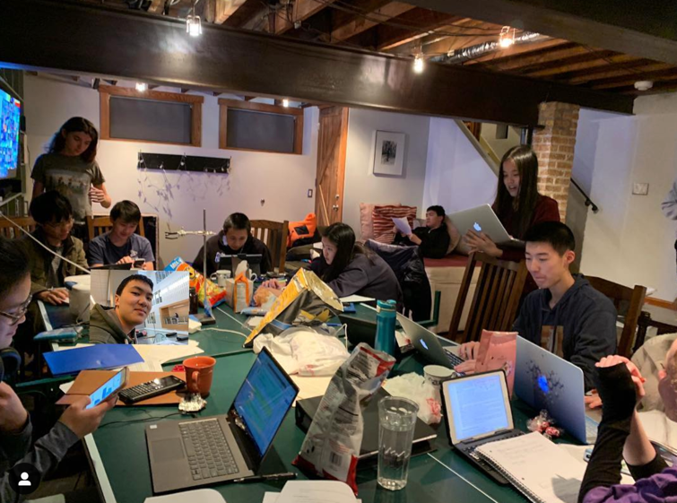
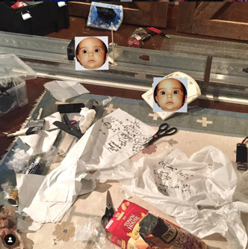
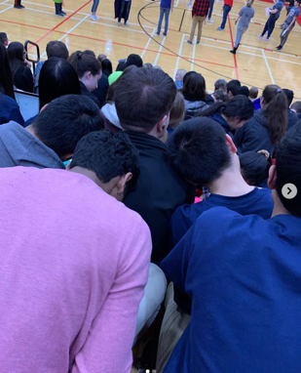
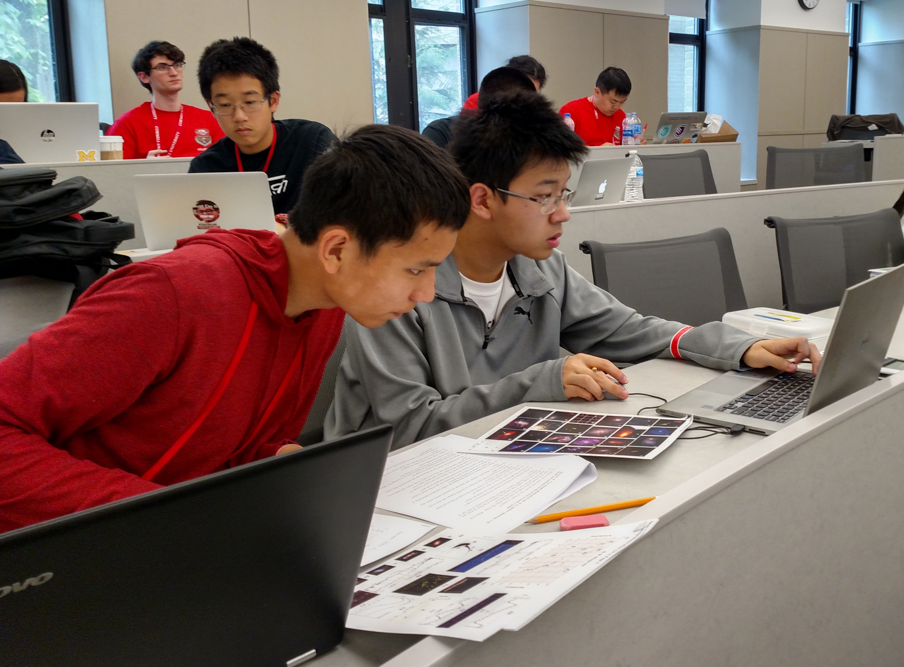
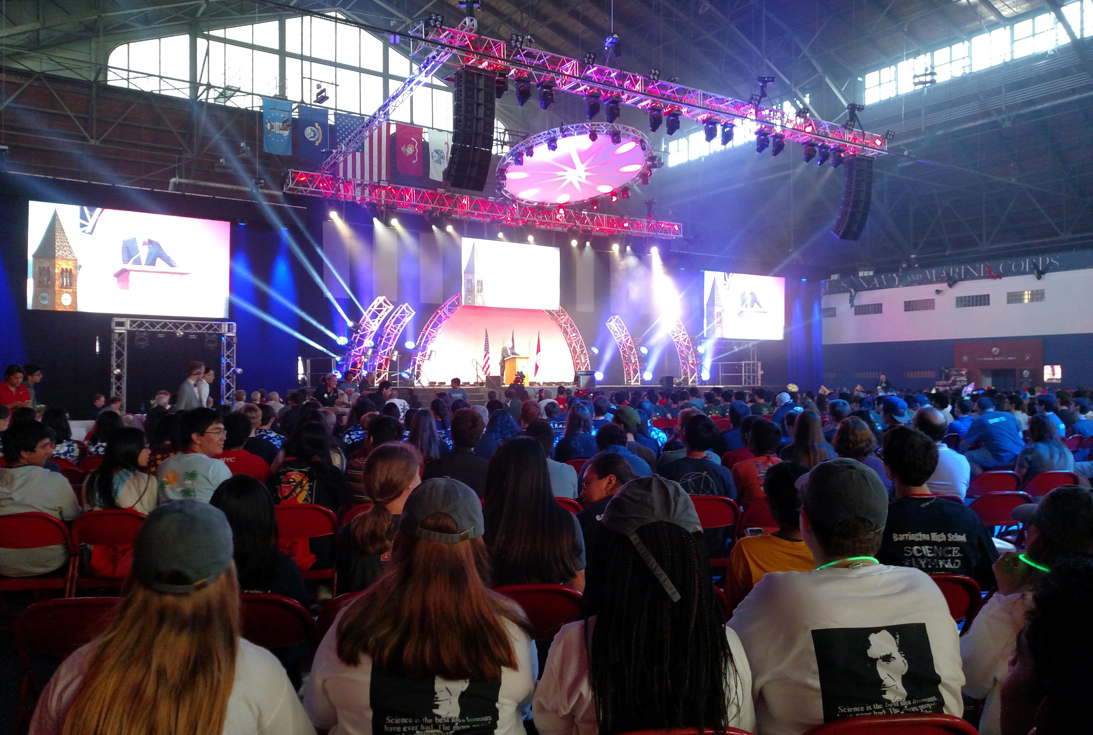
What It Looks Like

Slide 5
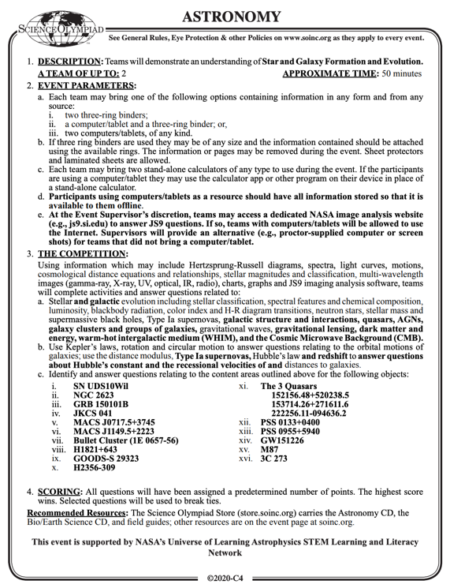
The Astronomy Event
Event Parameters
Laptops and Binders
2 competitors
No internet
Theory (CMB, H-R Diagram, etc.)
Computation
Deep Sky Objects (DSOs)
Scoring and UoL Funding

Slide 6
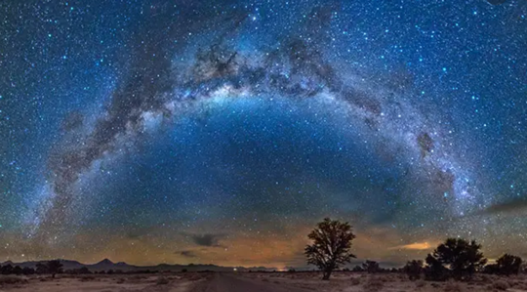




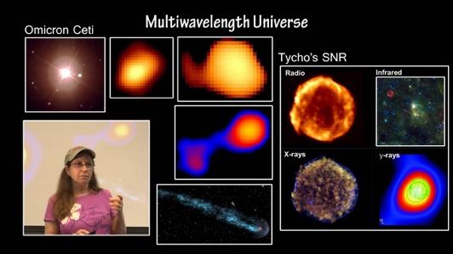
My Story

Slide 7
My Story: Generalized
Inspiration (0-10)
Exploration (11-18)
Specialization (18+)
78% alumni in a n=447 study said S.O. influenced their Career choice

Slide 8
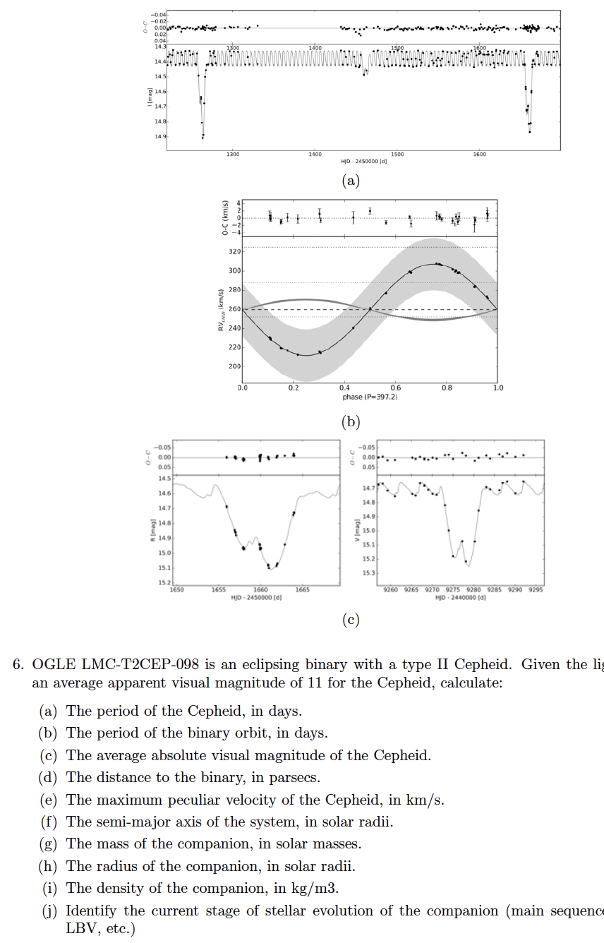
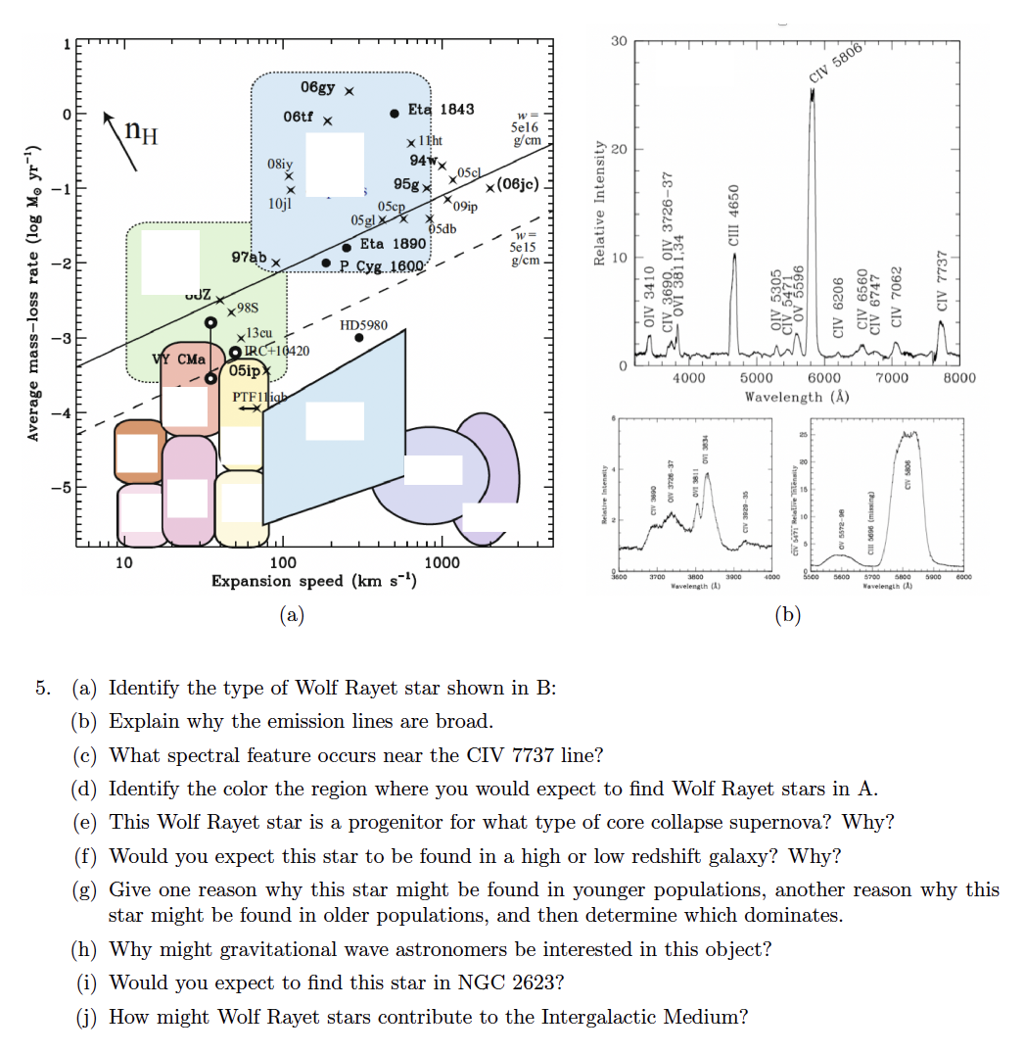
TOPICS: Theory
1
• Conceptual
Understanding
• Computation
2

Slide 9
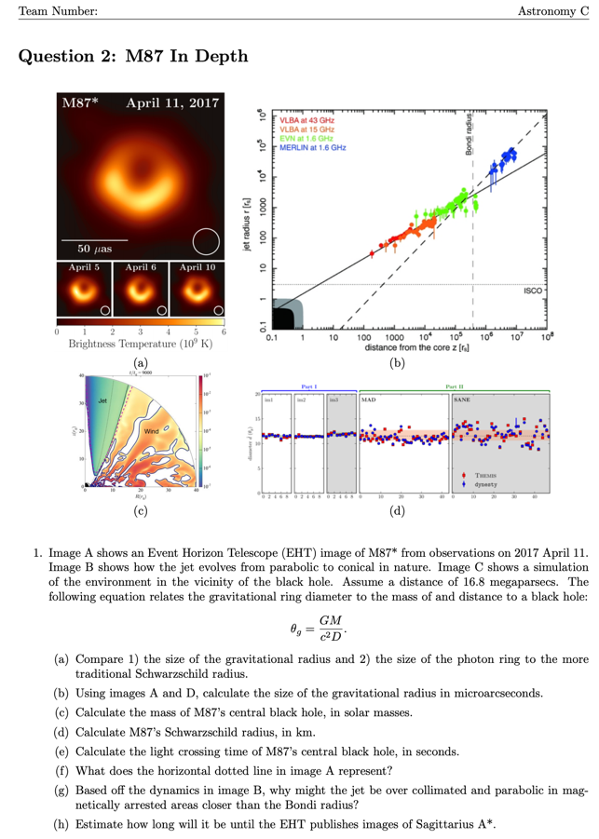
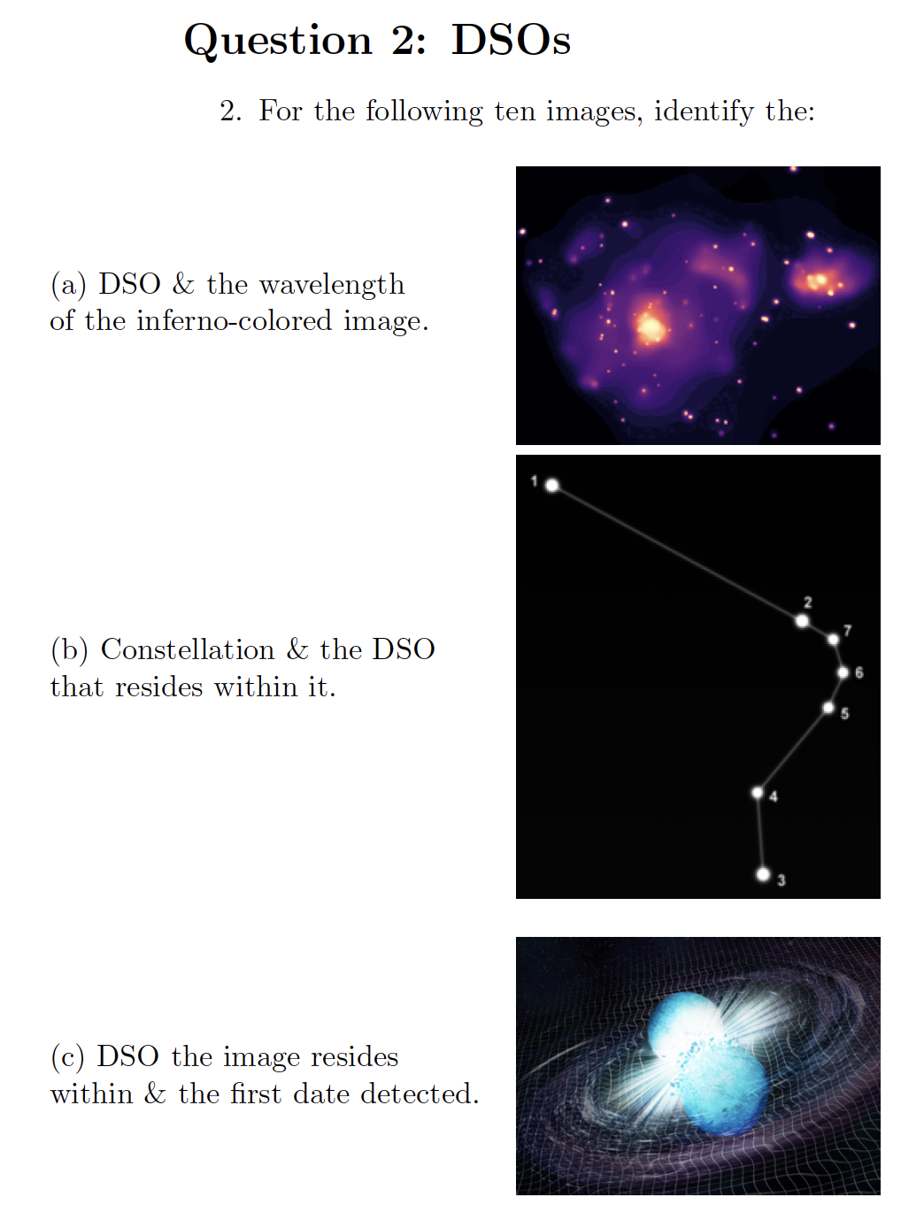
TOPICS: DSOs
1
• Identification
• Conceptual
Understanding
INTRODUCTION
TOPICS
2

Slide 10
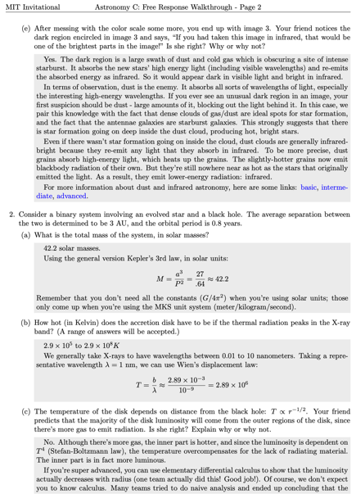
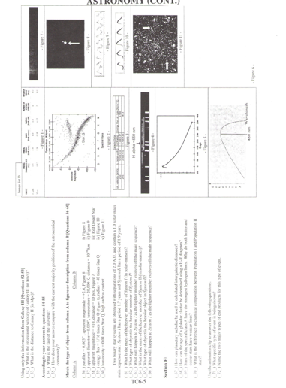
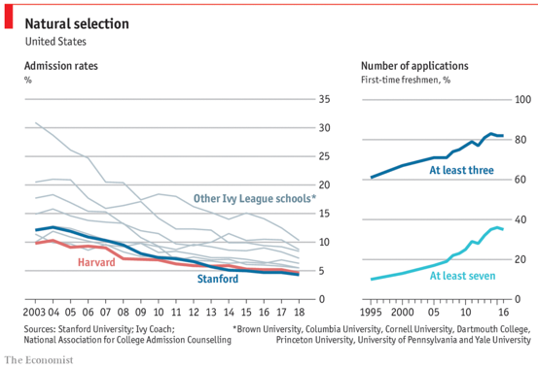
Increasing Competition
MIT 2019
Nationals 2005

Slide 11
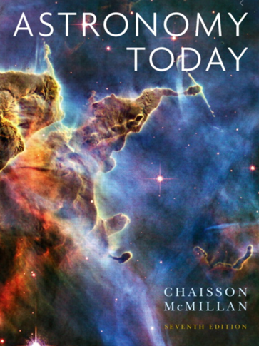

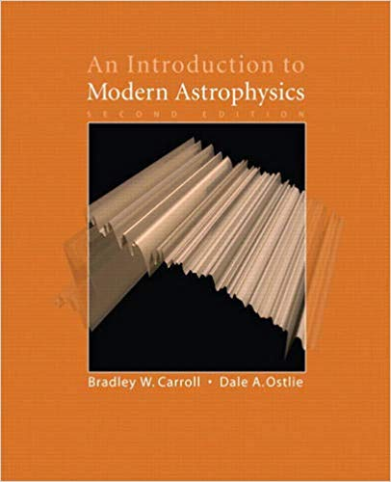
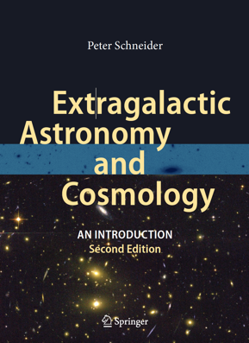
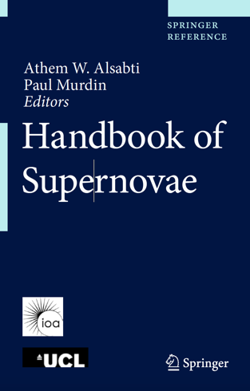
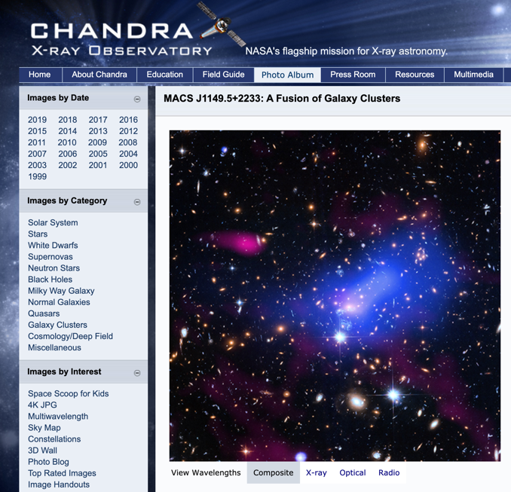
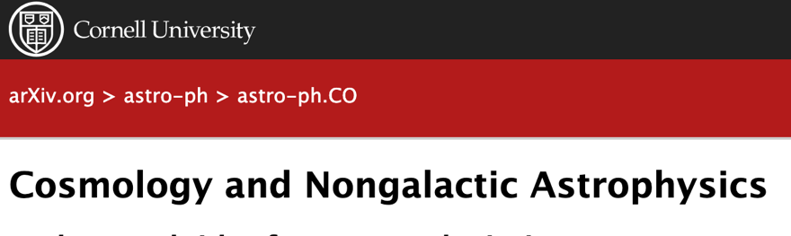
Astronomy 2020
2017
2018
2019
2020

Slide 12
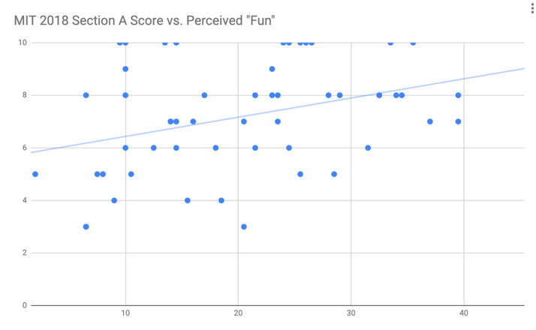
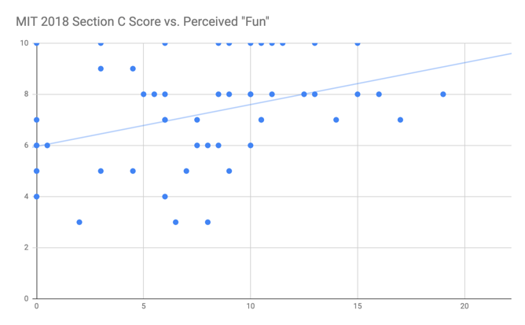
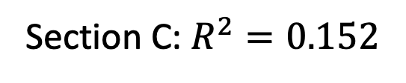
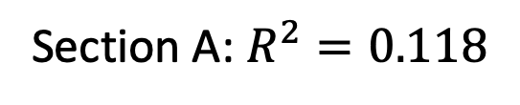
Welcomed Difficulty?
MIT 2018 Post-Event Feedback Form Results
Section A: $R^{2}=0.118$
Section C: $R^{2}=0.152$

Slide 13
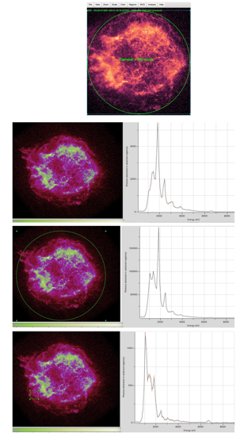
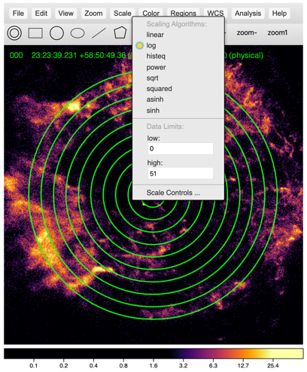
JS9: Live Image Analysis

Slide 14
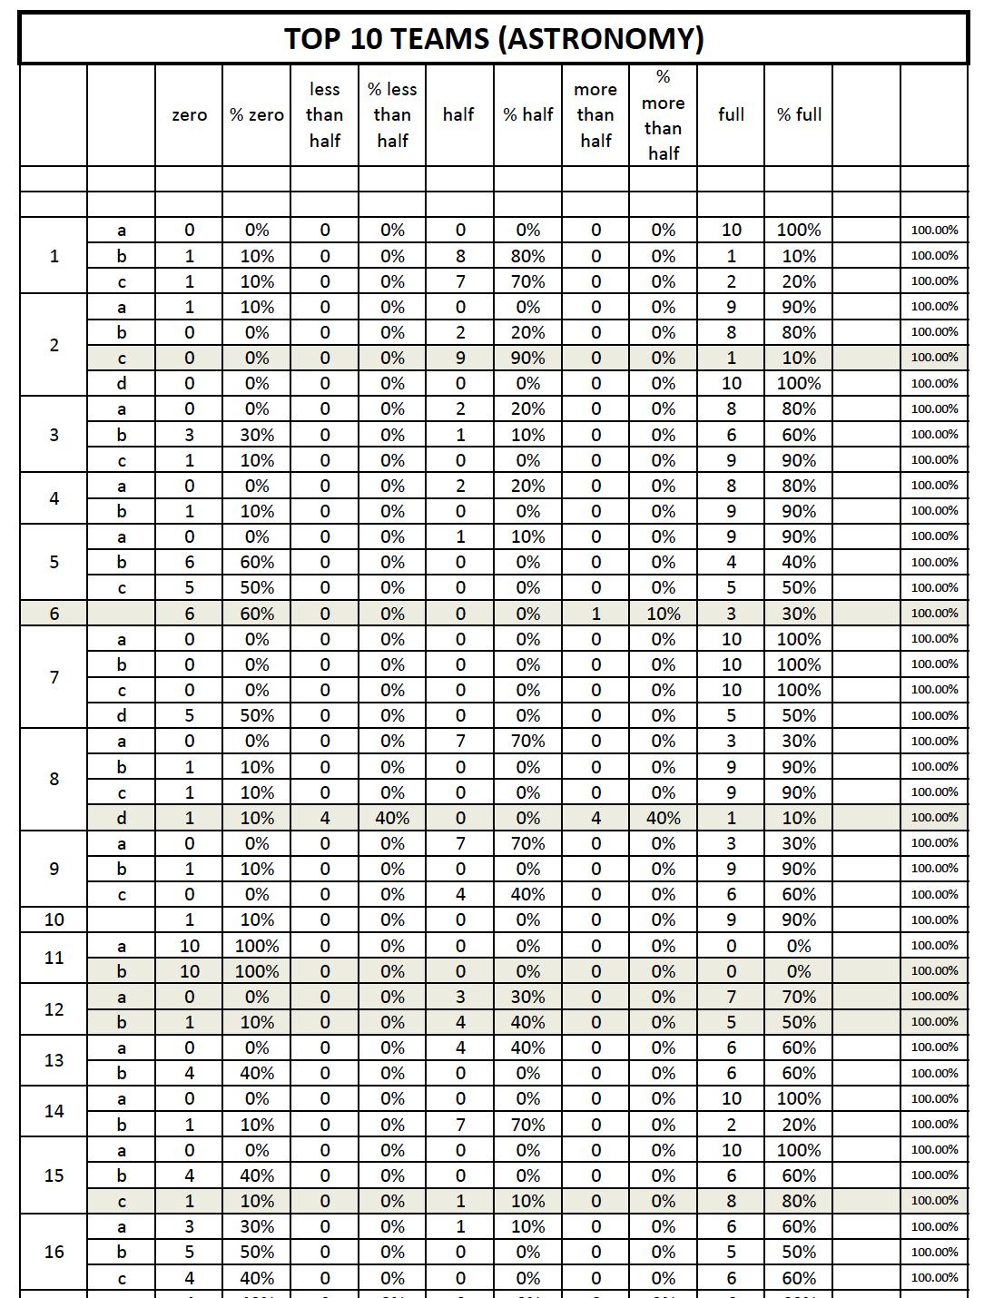
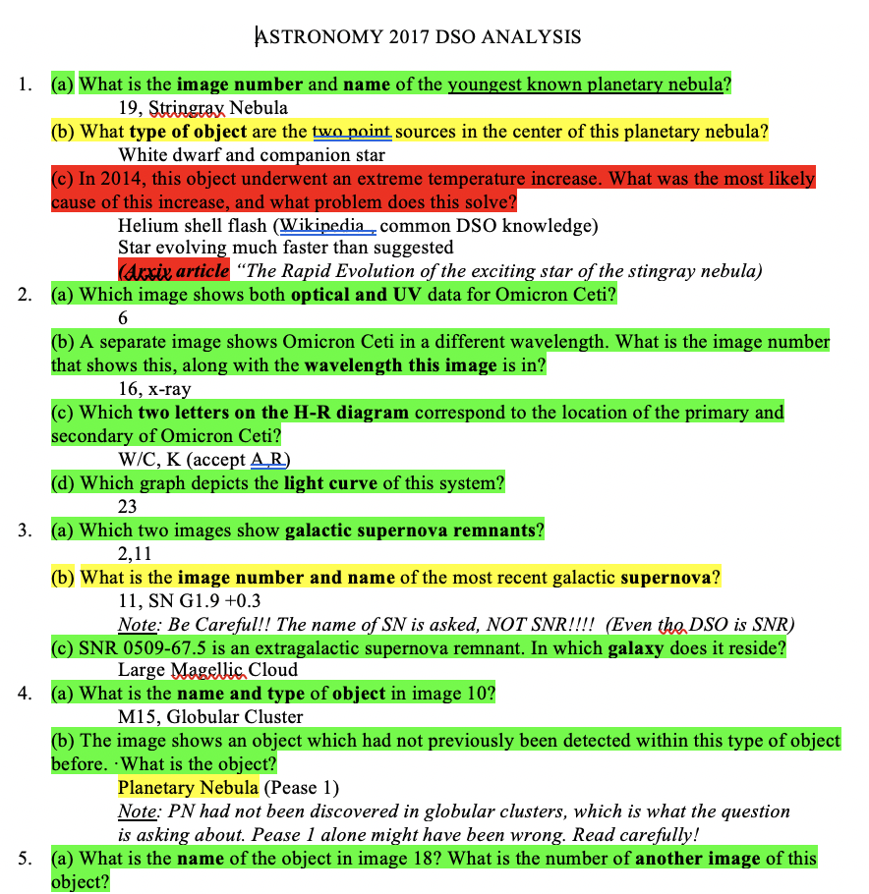
Writing with Intent
1
• Predict Difficulty
• Case Analysis of
Results
2

Slide 15
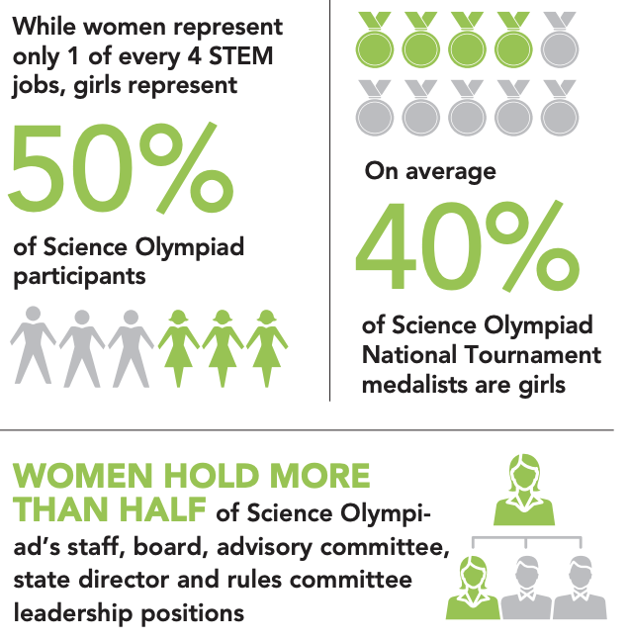
Representation

Slide 16
GET INVOLVED
LOCALLY
Volunteer at one of the 450 annual tournaments across the country
Coach at a local school district
Help start a program in a local school district
NATIONALLY
Join our team! Contact me, Donna Young, or Tad Komacek
Last year, our team wrote for about 30 competitions, including 9 state tournaments
This year, we will write for 45+ competitions, including 13+ state tournaments

Slide 17
References
APPENDIX
https://scholarship.shu.edu/cgi/viewcontent.cgi?article=1014&context=dissertations
https://www.facebook.com/SOAlumniNetwork/photos/?tab=album&album_id=207747459345716
https://twitter.com/stevensonhs/status/867038374129000448
https://www.soinc.org/snapshots/national-member-map
https://store.soinc.org/us/Digital-Test-Packets/c/2723/Test-Packet-2018-Division-C/p/90651
https://www.soinc.org/snapshots/2020-brochures
https://www.soinc.org/sites/default/files/uploaded_files/SO_2020_GirlsinSTEM.pdf
https://www.economist.com/graphic-detail/2018/09/07/americas-most-exclusive-university-will-no-longer-tout-its-exclusivity

Slide 18
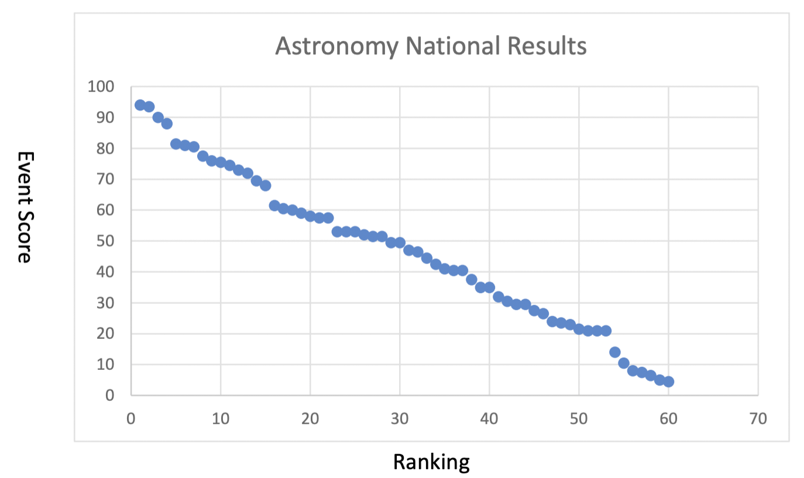
National Score Distribution
APPENDIX

Slide 19
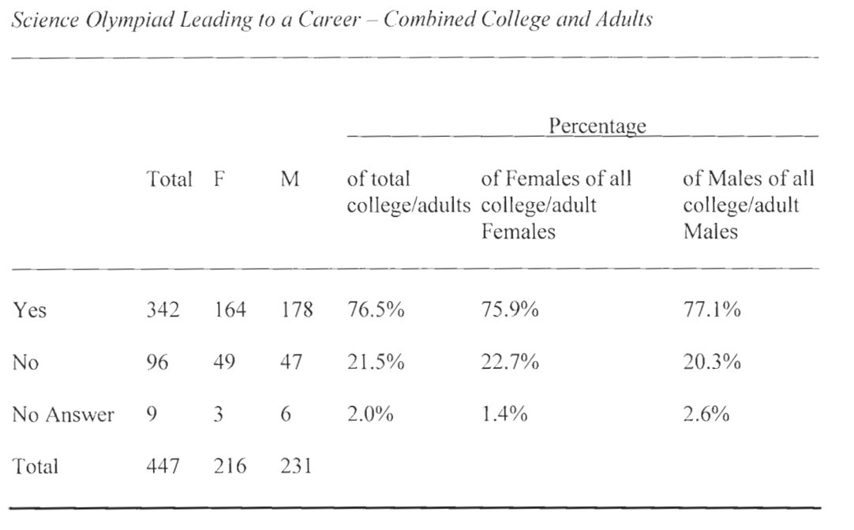
Full Career Choice Table
APPENDIX

Slide 20
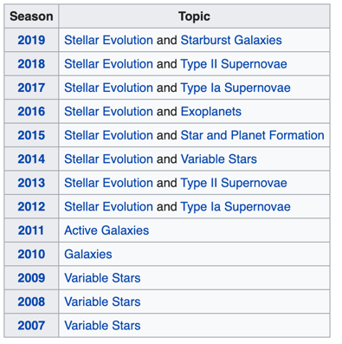
Astronomy Topics over Time
APPENDIX

Slide 21
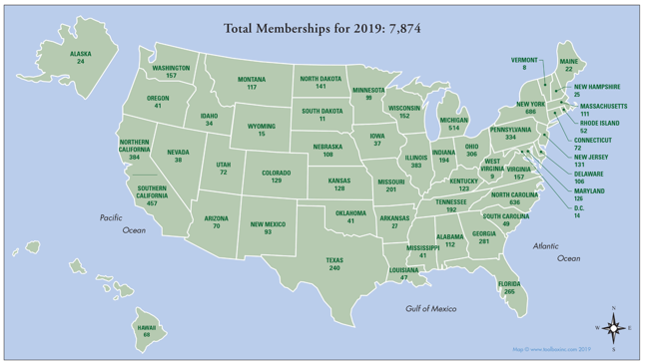
Science Olympiad Membership
APPENDIX

